Slide 1


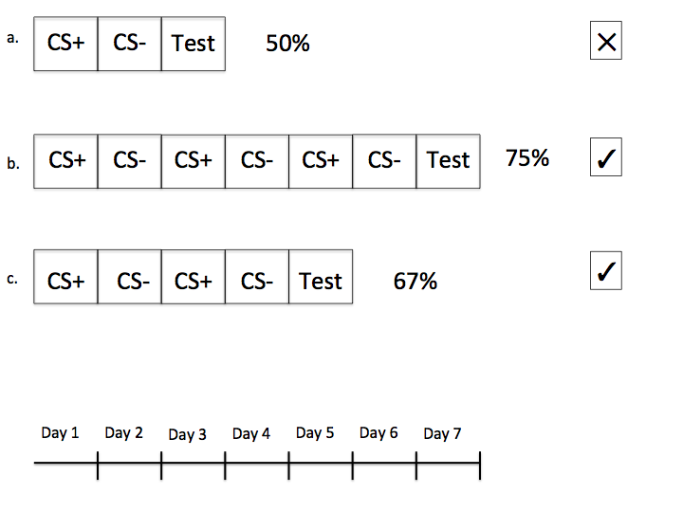
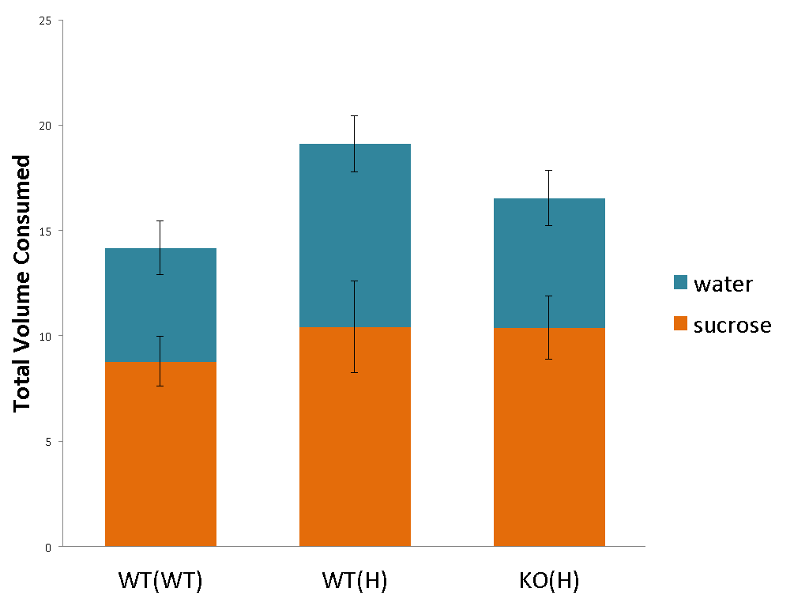
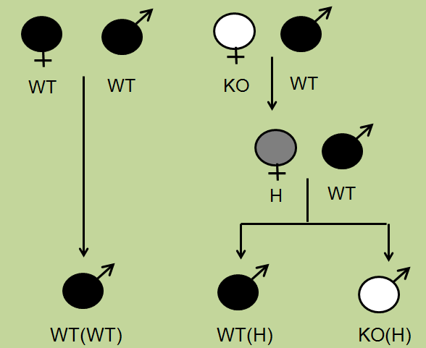
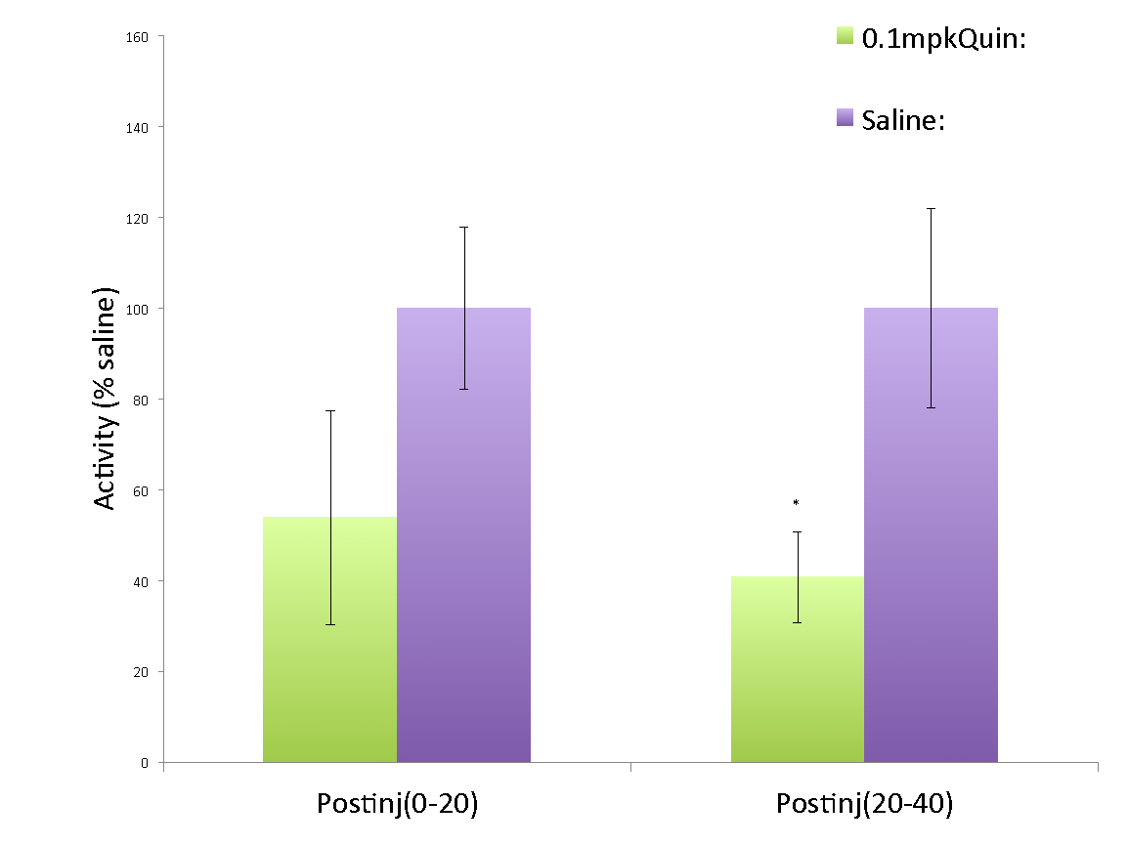
Challenges of establishing an acquisition curve in sucrose conditioned flavor preference
Sophie R.M. Dewil, Michelle A. Morochnik and Bojana Zupan
Psychology Department, Neuroscience and Behavior Program, Vassar College, 124 Raymond St. Poughkeepsie, NY, 12604
Introduction
1. Effect of reinforcement schedule on acquisition rate
2. Is there a difference in baseline preference for sucrose between genotypes? -- Sucrose Preference Control
Fragile X Syndrome (FXS), the most common single gene cause of autism, is caused by the mutation of the FMR1 gene (Chonchaiya et al. 2009; Zupan & Toth 2012). The mouse model for FXS in which a homologous fmr1 gene is deleted (fmr1-KO) shows comparative locomotor and learning deficits, potentially mediated by dopamine signaling abnormalities (Fulks et al, 2010). Specifically, a deficit in D2 autoreceptor synthesis attenuates negative feedback mechanisms of dopaminergic neurons, causing an increase in tonic and blunted phasic dopamine release (Starke et al., 1989). In the Nucleus Accumbens (NAc) of mice, this has been shown to disrupt Sucrose Conditioned Flavor Preference (SCFP) (Muscat & Willner 1989).
Previous studies in our lab have shown an effect of maternal fmr1 genotype on D2 autoreceptor expression in offspring ventral tegmental area (VTA), from which DA neurons project to the NAc (Zupan & Toth 2008; Gale, J., Chu, D., & Zupan, B. 2015). Furthermore, our lab has shown that the D2 agonist quinpirole fails to inhibit SCFP expression in mice derived from fmr1 deficient, but not WT dams (Zupan et al. 2015). Therefore we asked whether differences in D2 autoreceptor expression can be detected by a quinpirole induced attenuation of SCFP acquisition? In other words, we have shown that quinpirole will alter expression of SCFP, can we now alter the rate at which subjects acquire SCFP?
Methods
Previous experiments conducted in order to study conditioned mediated flavor preference acquisition. CS+ consisted of water infused with either grape or cherry Kool Aid flavoring and 10% sucrose. CS- was the flavor not used as CS+ with no sucrose added. a. Experiment 1 creating a 50% reinforcement schedule. Mice showed no SCFP. b. Experiment 2 creating a 75% reinforcement schedule. Mice showed SCFP on testing day 1. c. Experiment 3 creating a 67% reinforcement schedule. Mice showed SCFP on testing day 1.
No effect of genotype on % sucrose intake (p > 0.05). Subjects significantly preferred sucrose to water (F(1,29) = 4.336, p = 0.046) regardless of genotype. WT(H) mice consumed significantly more overall than WT(WT) mice (F(2,31) = 4.918, p = 0.014). The slight decrease in sucrose preference in WT(H) (not sig) is likely due to the overall increase in water consumption in WT(H). This lack of a genotype effect confirms findings by Smith, L. et al. (2014).
Subjects:
fmr1-KO and WT mice of the FVB strain were used to breed 40 male mice in accordance with the figure. Parenthetical information notes maternal genotype. All animals were housed in groups of up to five per cage with a 12 h light/dark cycle and ad libitum access to water.
3. Is our current dose of quinpirole successfully suppressing DA release? -- Quinpirole Locomotor Control
Discussion
A series of modified sucrose conditioned flavor preference acquisition experiments could not successfully achieve an acquisition curve.
We therefore conducted control experiments and found that our materials and methods were in fact producing the expected effects.
We concluded that the difficulties in creating a learning curve modeling SCFP acquisition are likely due to the highly concentrated sucrose solution
Zukerman et al. (2009) found that at 8% sucrose concentration mice displayed 100% sucrose preference
In future experiments, we will utilize a lower concentration of sucrose in testing sucrose mediated flavor preference.
In our control experiment we utilized a 1.5% concentration of sucrose and mice did not display a learning curve. However, the sucrose preference was very low--mice rarely showed more than 60% preference of sucrose.
Sucrose conditioned flavor preference acquisition:
Over a training period mice were presented with two flavors (cherry and grape Kool Aid), one of which was positively reinforced by a 10% sucrose additive (CS+).
Mice were habituated in single housing cages for 30 minutes and then allowed to choose between two spouted water bottles with either cherry or grape flavoring and a .2% saccharin additive.
At the end of the 30 minute testing time, bottles were weighed by difference to determine amount of each solution consumed.
Sucrose acquisition control:
Mice placed in single housing with ad libitum access to two spouted water bottles and taught to drink from spout.
One bottle then filled with a 1.5% sucrose solution while the other was filled with water.
Bottles weighed every 24 hours and positions switched every 12 hours.
After 4 days of testing mice were returned to group housing.
Quinpirole locomotor control:
Mice placed into a corner of a rectangular Plexiglas enclosure and allowed to freely explore for 20 minutes, injected with quinpirole or saline and allowed to freely explore for another 40 minutes
Animals’ movement tracked by a camera and Smart v3 software.
All procedures were carried out in accordance with the Vassar College IACUC guidelines.
References
Chonchaiya, W., Schneider, A., & Hagerman, R. J. (2009). Fragile X: a family of disorders. Advances in pediatrics, 56(1), 165-186.
Fulks, J. L., Obryhim, B. E., Wenzel, S. K., Fowler, S. C., Vorontsova, E., Pinkston, J. W., … Johnson, M.(2010). Dopamine release and uptake impairments and behavioral alterations observed in mice that model fragile X mental retardation syndrome. ACS Chemical Neuroscience, 1(10), 679–690.
Gale J, Chu D and Zupan B (2015). Maternal Fmr1 mutation reduces D2S expression in offspring VTA but not SN. Poster presented at Hudson Valley Life Sciences Group Spring Research Symposium, Bard College, April 30, 2015 and Vassar College Neuroscience and Behavior Symposium, Poughkeepsie, NY, May 7, 2015.
Muscat, R., & Willner, P. (1989). Effects of dopamine receptor antagonists on sucrose consumption and preference. Psychopharmacology, 99(1), 98-102.
Smith, L. et al. (2014). Fragile X Mental Retardation Protein Regulates Synaptic and Behavioral Plasticity to Repeated Cocaine Administration. Neuron, 82(3), 645-658.
Starke, K., Gothert, M., Kilbinger, H. (1989).Modulation of neurotransmitter release by presynaptic autoreceptors. Physiological Reviews, 69 (3), pp. 864-989.
Zukerman, S., Touzani, K., Margolskee, R. F., & Sclafani, A. (2009). Role of Olfaction in the Conditioned Sucrose Preference of Sweet-Ageusic T1R3 Knockout Mice. Chemical Senses, 34(8), 685-694.
Zupan, B & Toth, M. (2008) Wild-Type Male Offspring of fmr-1(+/−) Mothers Exhibit Characteristics of the Fragile X Phenotype. Neuropsychopharmacology, 11, 2667-2675.
Zupan, B., & Toth, M. (2012). Fmr-1 as an offspring genetic and a maternal environmental factor in neurodevelopmental disease. In Modeling Fragile X Syndrome (pp. 243-253). Springer Berlin Heidelberg.
Zupan, B., Choe, M., DiPace, C., Toth, M. (2015). Non-genetic transmission of abnormal social phenotype in a mouse model of FXS. Int J Dev Neurosci. 47(Pt A):99-100.
There is a decrease in movement in quinpirole injected mice 20-40 minutes after injection compared to saline control (F(1,12) = 5.033, p = 0.045). * p < 0.05

